Slide 1
Design Review & Critique
BB1 Multidisciplinary Capstone Team
Bingyue Wang
Shuwen Cao
Mahtabsadat Amiri
ZhiQing Xu
Christopher Prost

Slide 2
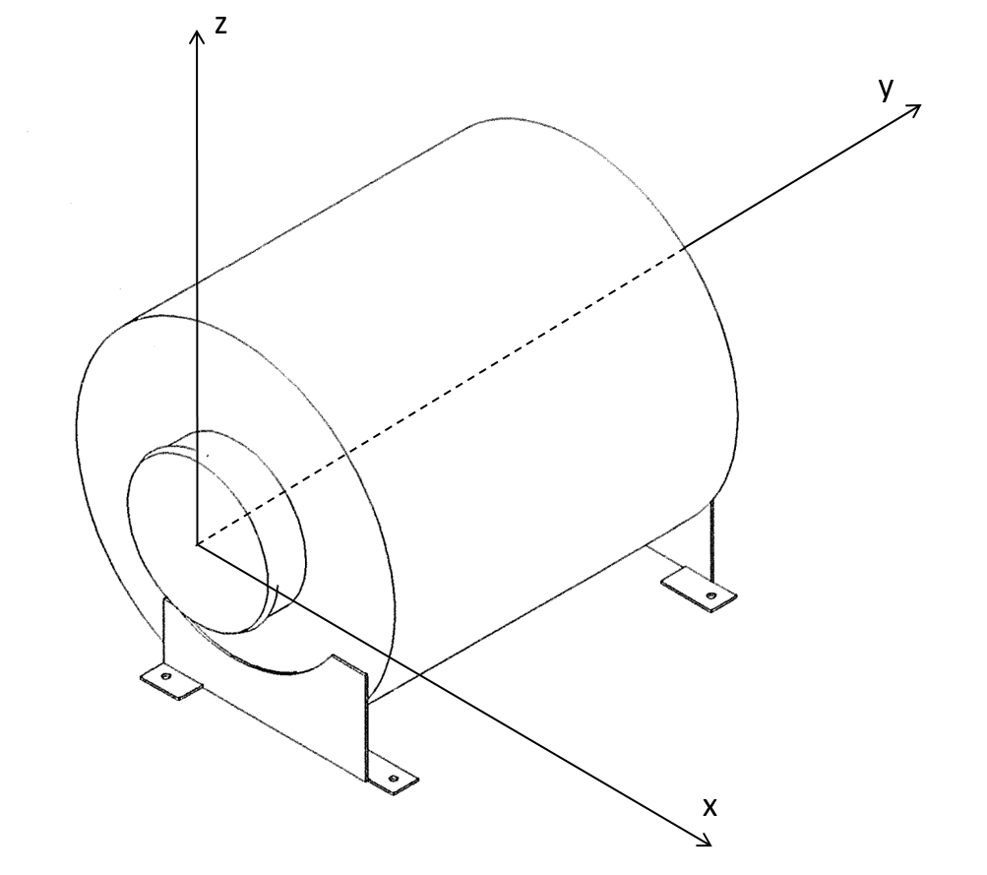
Introduction
Bombardier currently has no methods of analyzing the remaining lifespans of filters on planes
As a filter is used, dust buildup reduces flow, causing an increased pressure differential across the filter
Filters may be thrown out prematurely, leading to significant wastage and increased costs
We seek to develop a standardized testing method for the pressure drop of three various air filters in their region of origin

Slide 3
Function
Must display the inflow and outflow pressures across an air filter
Objectives Easily adjustable for various filters Portable Easily operated Minimum cost | Constraints Not affect the filter’s functionality Comply with Bombardier Inc.’s testing parameters Comply with ergonomics standards for transportation Be safe to operate

Slide 4
Service Environment
Table 1: Input Parameters
 | Cabin Air Distribution Recirculation Filter | Front Fuselage LCD Cooling Filter | Pressurization Control Aft Safety Valve Filter
Air Flow Rate | 57 lb/min | 2.4 lb/min | 0.102 lb/min
Temperature | 27 °C | 5-25 °C | 21 °C
Pressure | 14.7 psi | 14.7 psi | 14.7 psi
Failure Criteria | 0.144 psi | 0.0144 psi | 0.0581 psi

Slide 5
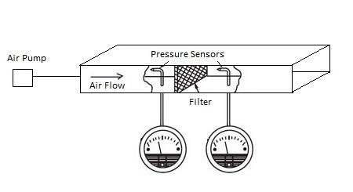
Proposed Design - Process Flow Diagram
Figure 1: Simple Process Flow Diagram

Slide 6
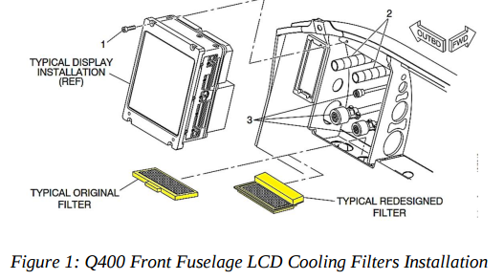
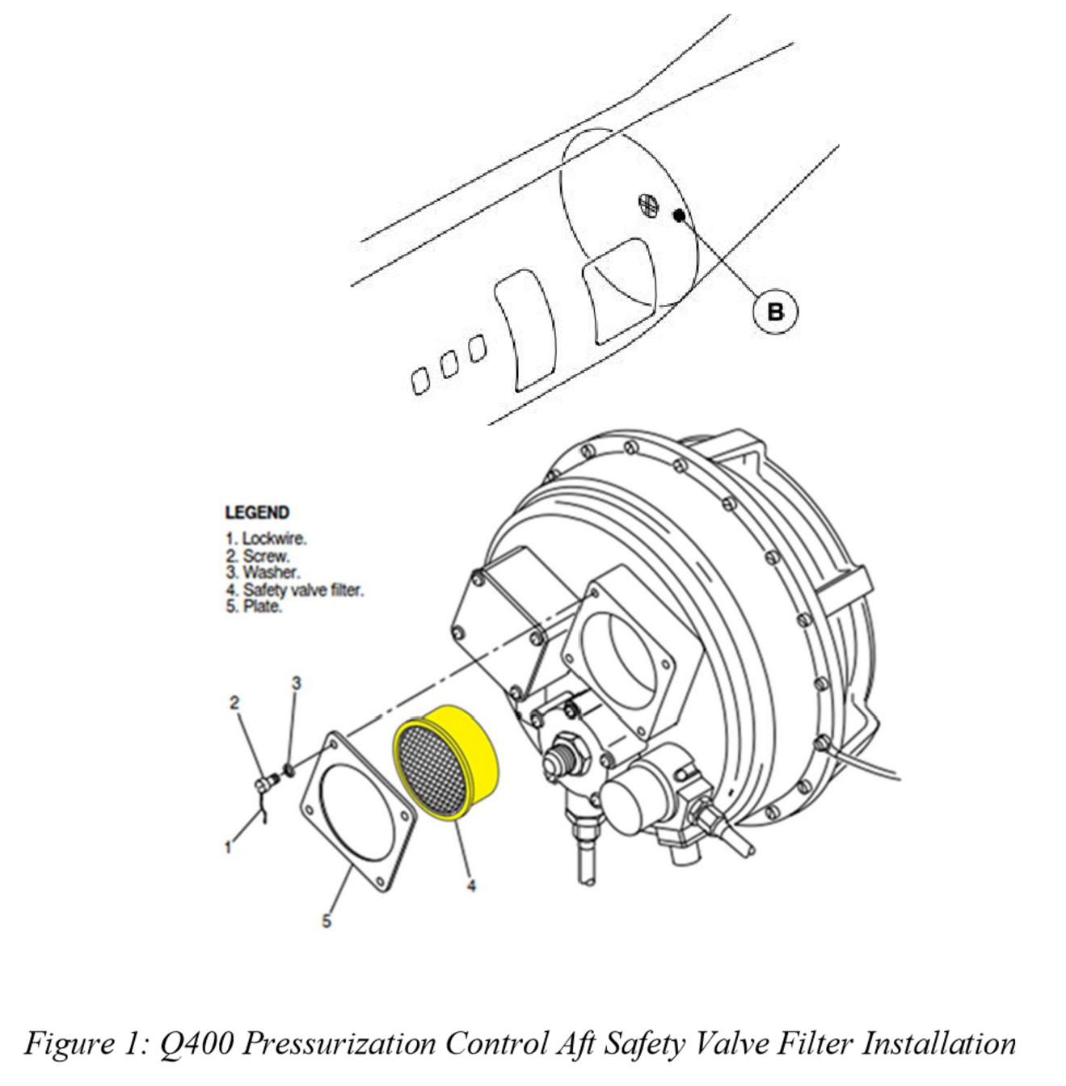
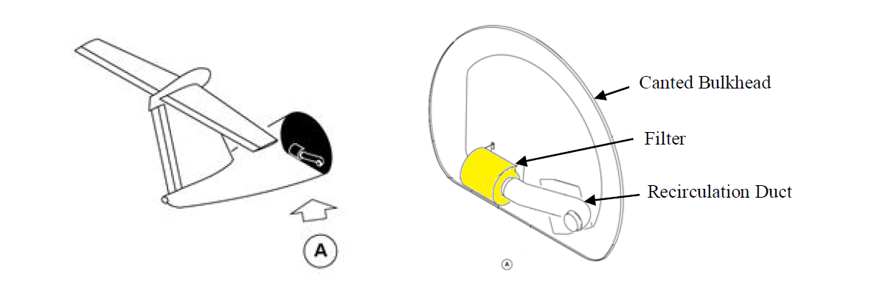
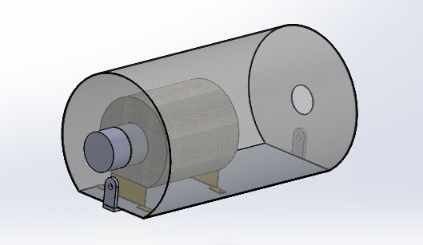
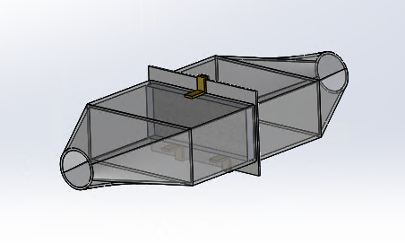
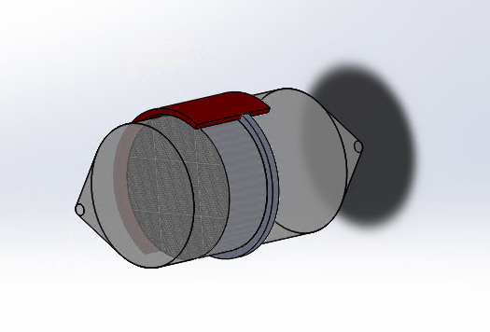
Proposed Design - Adapter System
Figure 2: Cabin Air Recirculation Filter
Figure 3: Front Fuselage LCD Cooling Filter
Figure 4: Pressurization Control Aft Safety Valve Filter

Slide 7
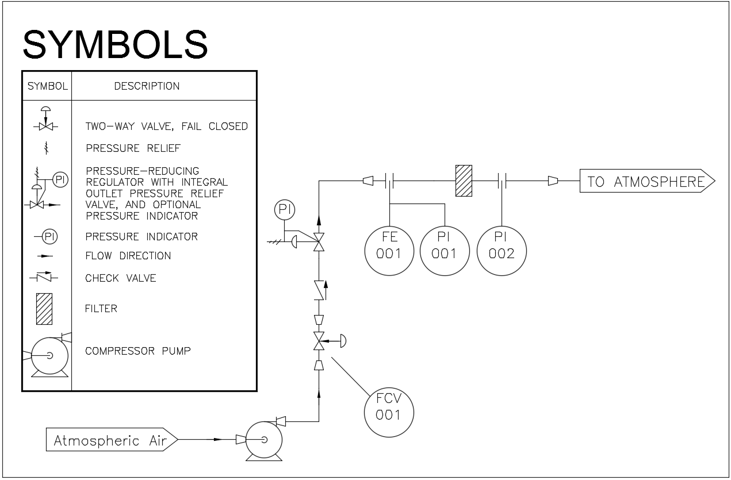
Proposed Design - P&ID
adapters
filter

Slide 8
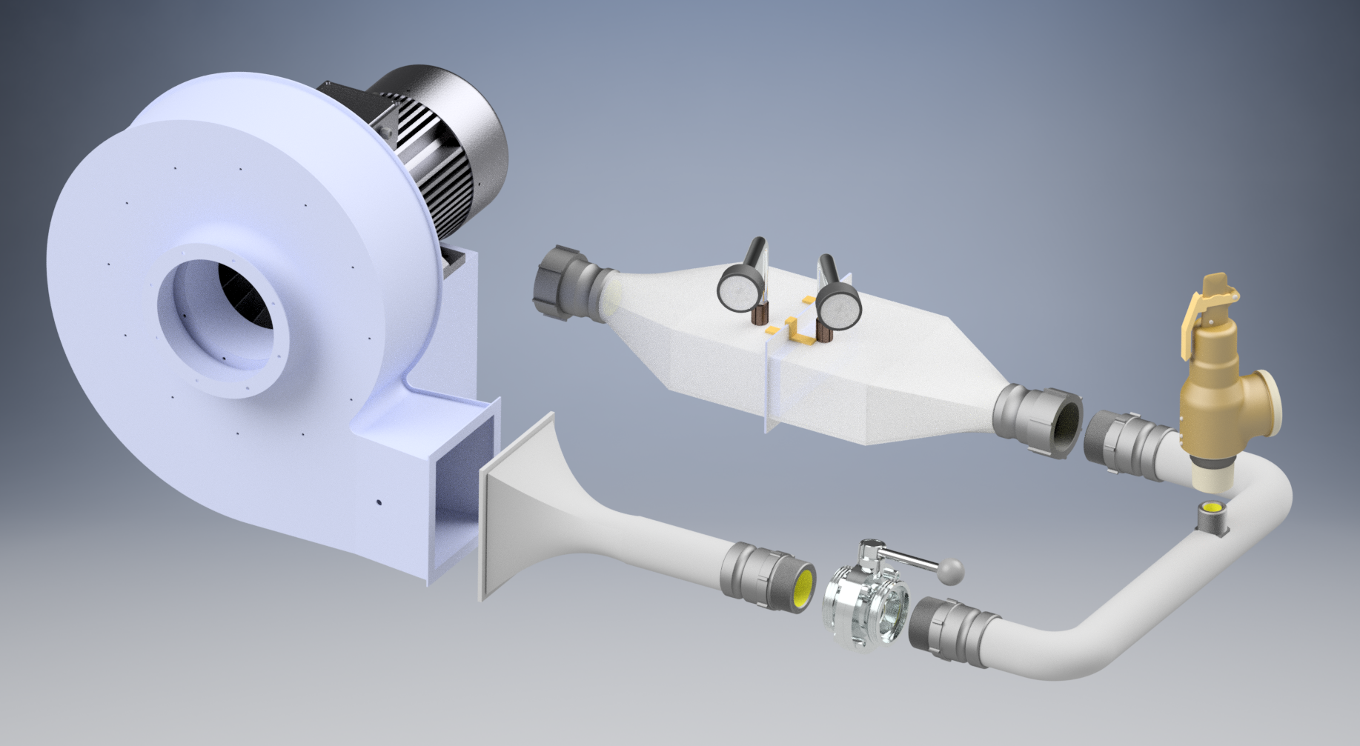
Proposed Design - CAD
Pressure Gauge
Safety Relief Valve
2” Pipe
Butterfly Valve

Slide 9
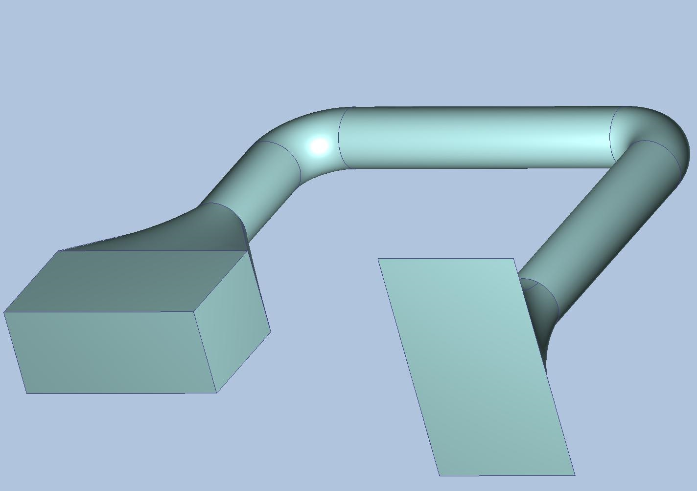
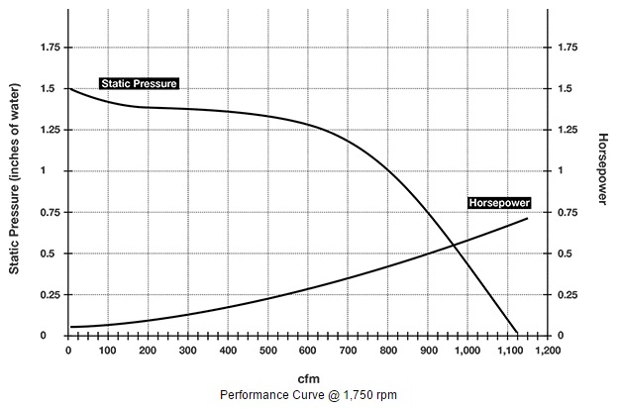
Proposed Design CFD analysis - LCD filter
Outlet of the compressor. Boundary condition set based on the performance curve.
Outlet of the simulation model, where the filter upstream pressure will be measured.

Slide 10
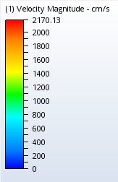
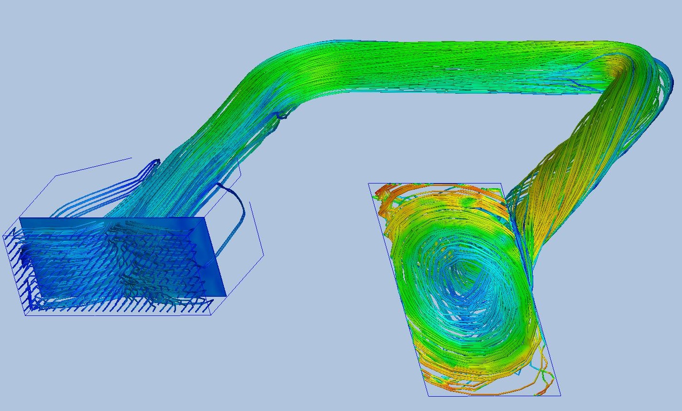
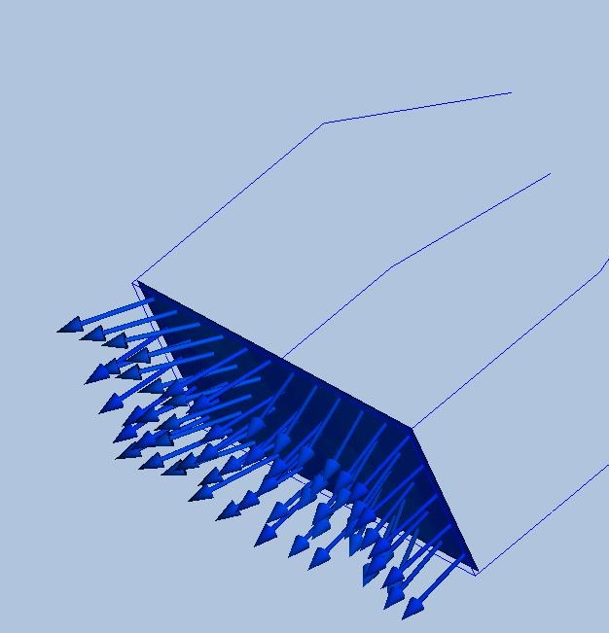
Proposed Design CFD analysis - Results
Velocity vectors
Particle-traces diagram

Slide 11
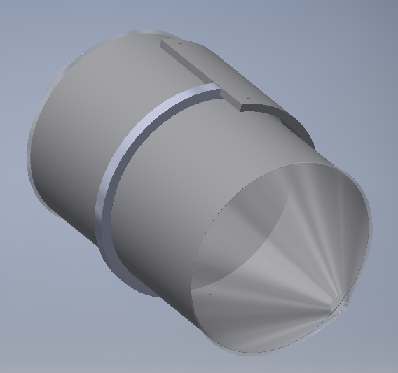
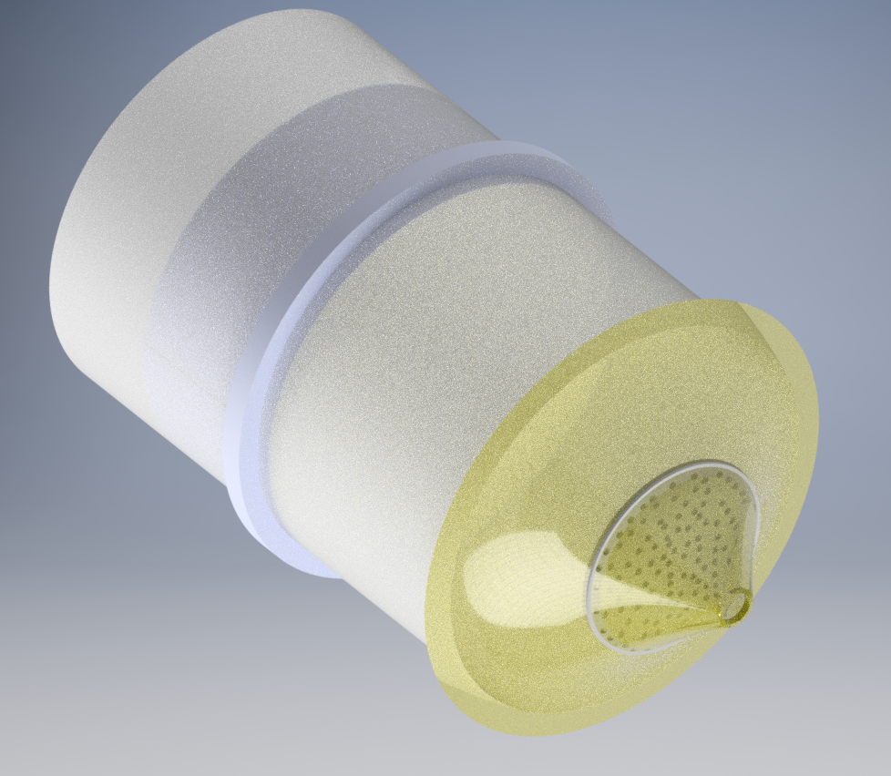
Proposed Design - Safety Valve Filter
mesh
Pressurization Control Aft Safety Valve Filter
Possible solution

Slide 12
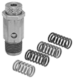
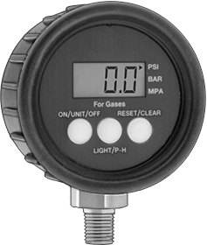
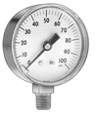
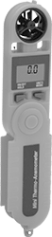
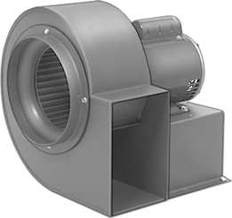
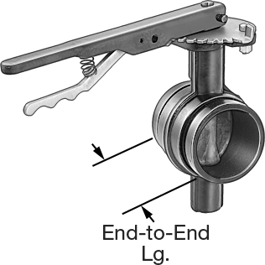
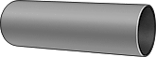
Economics
Standardized off-the-shelf components selected for ease of maintenance
Total Cost: $1,129.45 [Appendix A.1]
Custom sections to be built using readily-available materials and tools
Consists primarily of semi-finished 304 stainless steel products
Designed for processing and shaping by standard machines
Non-separable parts to be welded using 316L stainless
Total Cost: $2,525.44 [Appendix A.2]

Slide 13
Life Cycle Analysis, Human Factors
Each part should be less than 50kg
Handles are available
Easy to be assembled and connected as per the design manual
Maintenance programs for simplifying repairs
Used filters/parts recycling/Disposal Plan

Slide 14
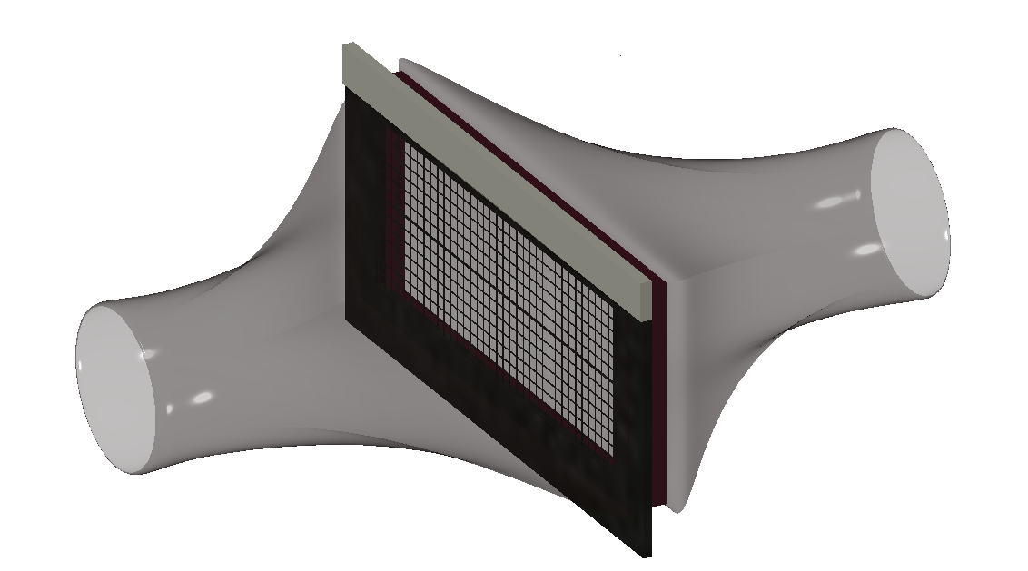
Design Updates
Changing the design of LCD filter adapter
Reason: not uniformly distributed
Effect: reduced complexity
Replacement of single-stage blower for standard blower
Reason: to meet volumetric flow rate requirements
Effect: cost savings of $439.17

Slide 15
Design Updates
Substituting analog anemometer to digital variant
Substituting analog pressure gauges for digital variants
Reason : not sufficient resolution
Effect: cost change and increased resolution
Removal of one anemometer
Reason : redundant
Effect: cost savings of $1058.65

Slide 16
Construction Plan
Raw material (Stainless Steel)
Welding → finished product
Product Shaping
→ achieved by press brake forming tools or air bending
→ curved parts is achieved by the use of tapering rolls
Component Joined
→ achieved by the use of bolts and clamps
→ filters are placed into the adapters and can be sealed by the
use of rubber gaskets

Slide 17
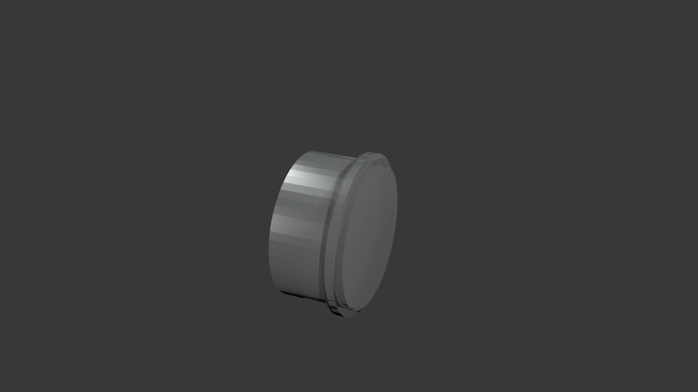
Demonstration

Slide 18
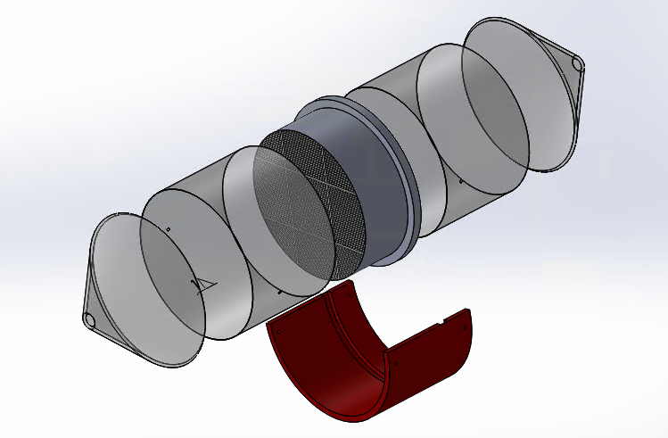
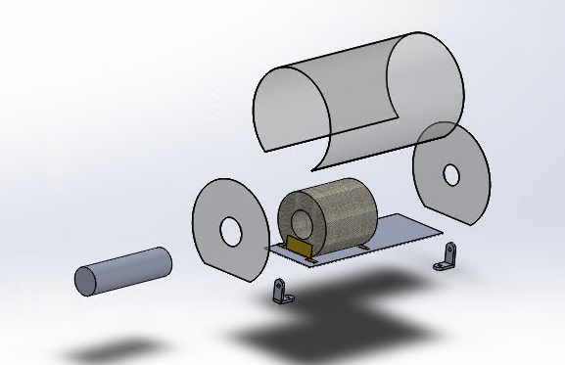
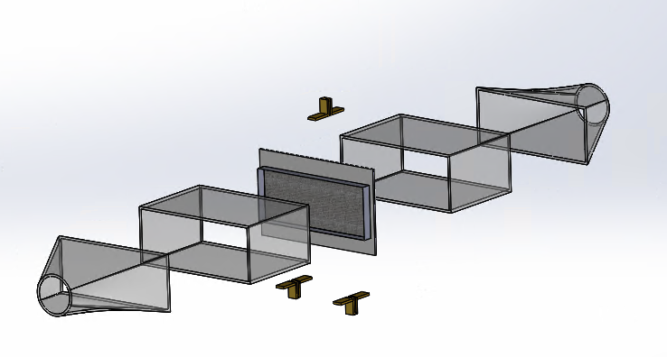
Pressurization Control Aft Safety Valve Filter
Front Fuselage LCD Cooling Filter
Cabin Air Recirculation Filter

Slide 19
Safety Analysis - Overview
Risk Matrix
Identify risk level of each failure mode
FMEA table
List all the failure modes that are associated with the major components of the design
Action plan
Recommended actions to take for safety improvement

Slide 20
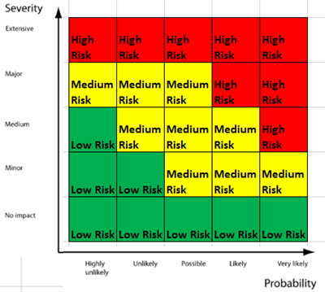
Safety Analysis - Risk Matrix
Severity vs. Probability
Risk Level
High risk: actions are needed if the problems appears during operation.
Medium risk: actions are recommended to take if the problems appears during operation
Low risk: actions may needed to take if the problems appears during operation
Risk Matrix

Slide 21
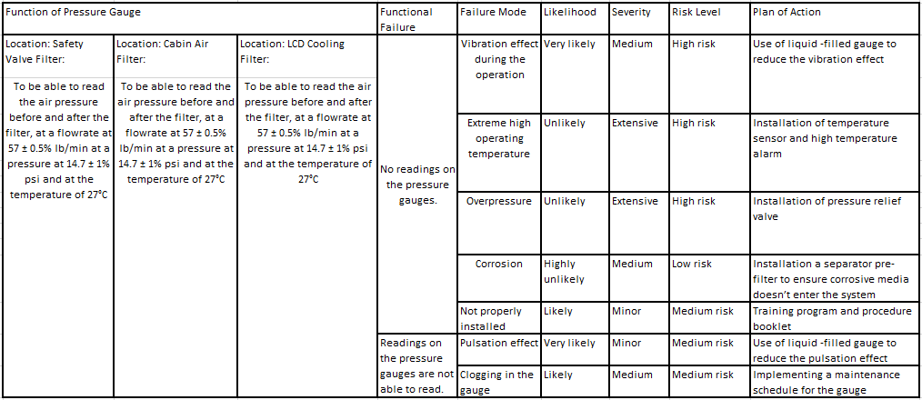
Safety Analysis - FMEA table on gauges

Slide 22
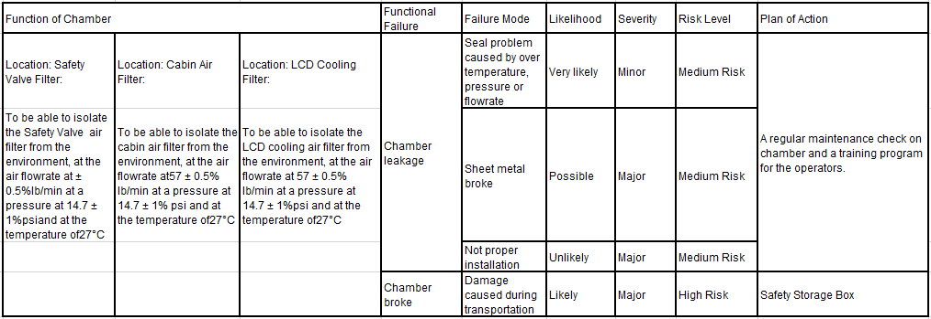
Safety Analysis - FMEA table on chambers

Slide 23
Future Plan
Some minor changes may occur for safety and convenience reasons
Possible changes:
The arrangement of pressure reducing valve
Control valve arrangement
Shapes of adapters

Slide 24
Contingency Plan
Risk | Probability | Effects | Strategy
Insufficient client feedback | Low | Expected project scope may change; Majority of design already complete | Maintain weekly correspondence and iteratively update design
Other schoolwork delays project | Low | Insufficient time to analyze potential room for improvement | Utilize weekly meetings to schedule around incompatibilities

Slide 25
Questions?

Slide 26
Appendix A.1: Off-The-Shelf Part Costs
Section | Item Description | Quantity | Operating Condition | Estimated Cost (each)
Air source | Standard rectangular blower | 1 | Maximum airflow rate: 1000 CFM | $397.27
 | Pump-adapter duct | 1 | 2” outer diameter; 5’ long | $22.42
Testing chambers | Anemometer | 1 | Range: 100-5500 CFM | $116.94
 | Pressure gauge - basic [29] | 1 | Connection size ¼ Range: 0-15 psi | $11.55
 | Pressure gauge - accurate | 2 | Range: 0-30 ps; 0.01 psi resolution | $92.60
Safety | Safety Relief valve[30] | 1 | Connection size: ¼ Range: 25-200 psi | $5.88
Other | Seal materials/ Connection units | various | --- | $75
Total (13% Tax Rate) |  |  |  | $1,052.25

Slide 27
Appendix A.2: Custom Component Costs
Section | Item Description | Quantity | Dimensions | Manufacturing | Estimated Cost (each)
Cabin filter adapter | Filter adapter fitting | 2 | 50” diameter, 36” long | Rolled 304 stainless steel; welded into cylinder | $259.20
 | Flat adapter end | 2 | 50” diameter, 24” long | Stamped 304 stainless steel; clamped onto filter adapter fitting | $86.40
Aft safety filter adapter | Filter adapter fitting | 2 | 50” diameter, 36” long | Rolled 304 stainless steel; welded into cylinder | $259.20
 | Tapered adapter end | 2 | 50” diameter, 24” long | Stamped 304 stainless steel; welded into cone | ~$400
LCD filter adapter | Filter adapter fitting | 2 | 7.50” wide, 6.48” tall, 30” long | Stamped & pressed 304 stainless steel; welded along seam into box shape | $49.74
 | Tapered adapter end | 2 | 4.2” wide*tall (narrow end); 7.50” wide * 6.48” tall (broad end) | Stamped and pressed 304 stainless steel; welded along seam; clamped to filter adapter fitting | $49.74
 | Flat adapter end (for duct) | 2 | 4.2” wide*tall | Stamped 304 stainless steel with removed hole | $13.17
Total (13% Tax Rate) |  |  |  |  | $2,525.44

Slide 28
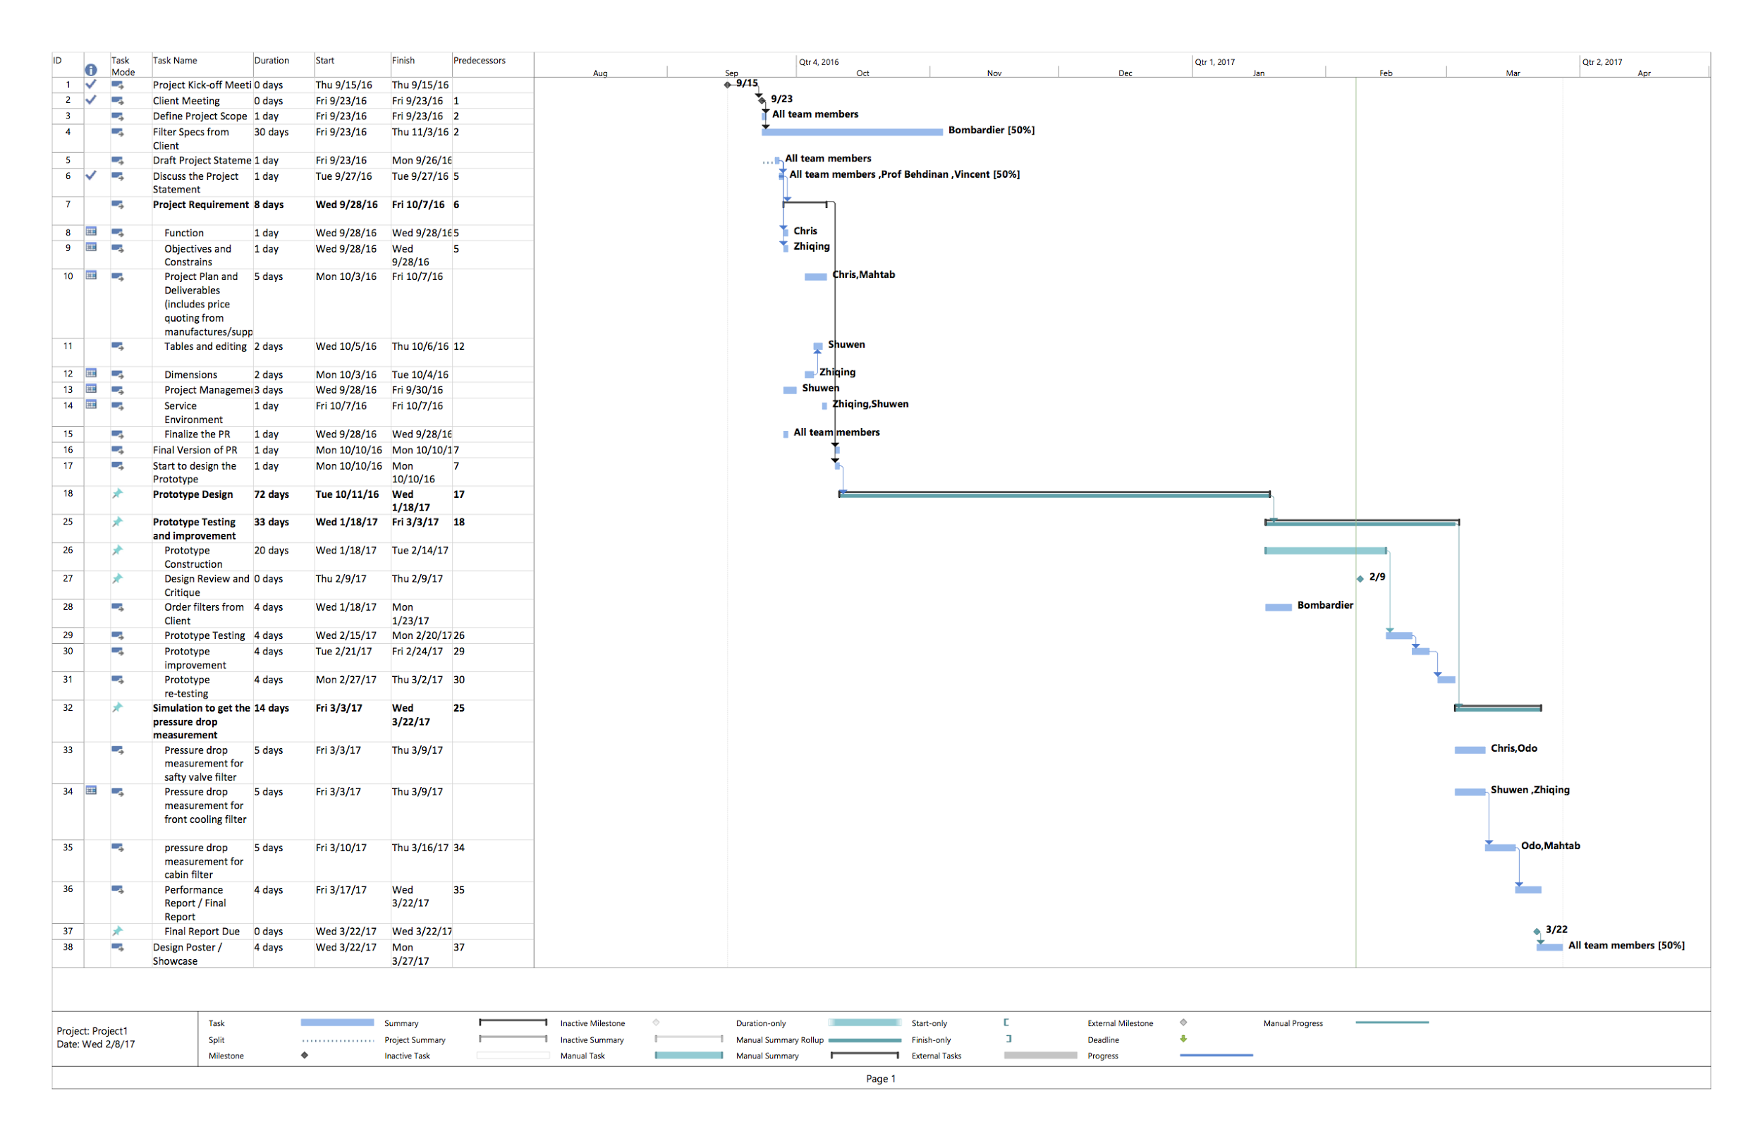
Appendix B Gantt Chart

